Slide 1
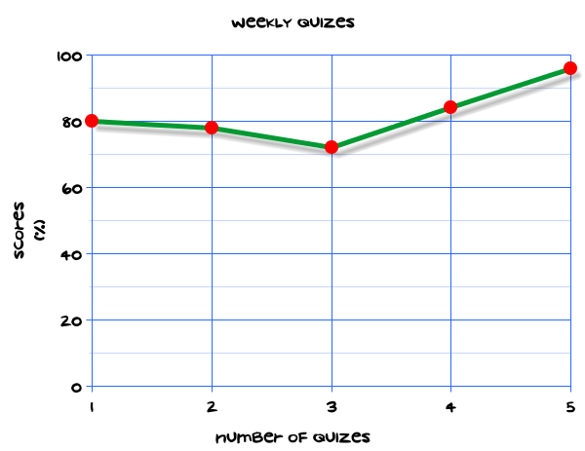
My Statistics Interactive Notebook
Name
Class
Teacher
Term 1 Semester 1
1

Slide 2
Create your own front page
It needs to contain the following –
My number interactive notebook
Name
Class
Teachers Name
Semester 1 Term 1
Page number 1

Slide 3
Contents
Glossary or Formula Page
Page
Date
Description
2
3

Slide 4
Tasks
24
7
30
Essential Question
Questions
Notes
Summary
4
5

Slide 5
24
7
30
Date
Title
EQ –
5

Slide 6
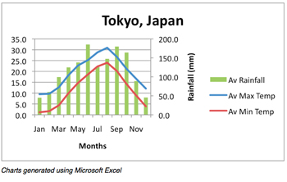
24
7
30
Date
Evaluating Statistical Reports
EQ –
What key items in a Statistical report are necessary in order to evaluate and interpret the data displays??
Which are the hot months?
Which are the wet months?
Which are the dry months?
Which are the cool months?
5

Slide 7
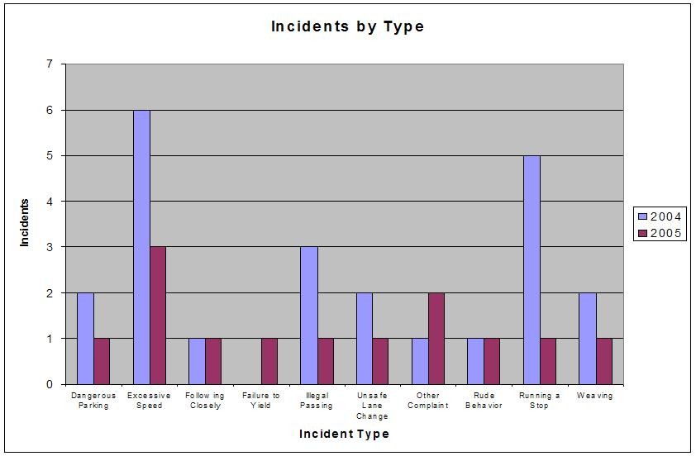
24
7
30
Date
Evaluating Statistical Reports
EQ –
What key items in a Statistical report are necessary in order to evaluate and interpret the data displays??
5

Slide 8
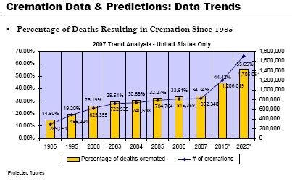
24
7
30
Date
Evaluating Statistical Reports
EQ –
What key items in a Statistical report are necessary in order to evaluate and interpret the data displays??
Comment on this report in terms of trends.
5

Slide 9
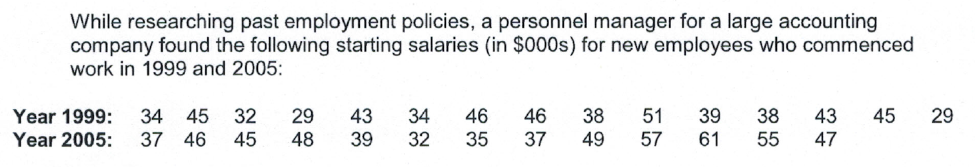
Task
The boxplots show the above data.
a) Referring only to the boxplots, compare the distribution of starting salaries in terms of their distribution, spread and shape.
b) Based on this data, estimate the proportion of all starting salaries that were 1) below $39,000 in 19999 and 2) above $39,000 in 2005.
c) Report on how the starting salaries have changed for employees of the company from 1999 to 2005 in general, and in particular for lower paid employees of the company. Use relevant answers from a) and b) to support your statements.

Slide 10
Questions

Slide 11
Notes Review
24, 7 ,30
Date
Title
Essential question
Notes complete
Notes complete with colour and diagrams
Questions completed
Contents page filed in
Formula page filled in

Slide 12
Homework
Review your notes and write a summary answering the essential question.

